Slide 1



Music Machine Learning
VIII – Approximate inference
Master ATIAM - Informatique
Philippe Esling (esling@ircam.fr)
Maître de conférences – UPMC
Equipe représentations musicales (IRCAM, Paris)

Slide 2
Approximate inference
Probabilistic inference mostly deal with simple distributions
Provide easier analytical solutions
Implicit assumption of a simple explanation (capacity)
Too simplistic assumption in most cases
Real data follows largely more complex distributions
These distributions are usually intractable
The almighty Gaussian
Real data ?
Modelling complex distributions but keep analytical simplicity ?
Entering the magnificent world of approximate inference
Either approximating statistics of the distribution
Sampling methods
Or optimizing simpler distributions to fit the true one
Variational inference
Normalizing flows
Adversarial learning

Slide 3
Approximate inference
So our big question today is …
How can we model real data (of unknown distribution)
With only simple tractable distributions ?
Real data ?
The almighty Gaussian
1st approach = can we approximate some properties ?
Calculate the expectation
Simply find some
Or just draw generative samples from

Slide 4
Sampling methods
We are going to see sampling methods
Considered as the silver bullet of probabilistic modeling
Very slow but guaranteed to converge
Understand the limitations
Idea of Monte-Carlo methods
You have a complicated problem
You cannot really work down the math
Instead you can simulate your problem lots of time
Example : Finding the value of with a shotgun
with

Slide 5
Monte-Carlo methods
Goal of Monte-Carlo is estimate expected values by sampling
We can define
with
This has nice co-properties
This is an unbiased estimator
Guarantees on the convergence
Then, we can use this estimator in more complex problems
For instance the M-step of the EM algorithm

Slide 6
Monte-Carlo methods
Advantages of Monte-Carlo
Very simple to program
Universally applicable to lots of problems
Scalable to parallelization
Problems
Usually very slow (need lots of samples)
Better solutions might exist
We will see the major sampling approaches
Rejection sampling
Markov Chain Monte-Carlo
Gibbs sampling
Metropolis-Hastings

Slide 7
Rejection sampling
Imagine that we have a complex distribution
We can upper-bound our distribution
Using approximation
We use constant 2 to truly upper bound
(impossible to upper bound a distribution without multiplying it with a constant).
Now we can sample from
How can we sample from ?
We know higher probability in
Need to *reject* some of the points

Slide 8
Rejection sampling
How do we reject some samples ?
Proportional to the height
We can take a sample
Take its coordinates
x
We accept with probability
if
We can even use this for unnormalized distributions

Slide 9
Markov chains
Markov chain is a sequence of random variables
Such that is independent of given
Markov property
Typically described with
Also noted as a transition
Stationnary distribution
A distribution is called stationnary if it converges to a fixed distribution

Slide 10
Gibbs sampling
Easiest method to construct Markov chains to sample from a distribution.
Say we have a distribution up to normalization
If we start from a given (random) point
We can start by sampling one dimension at a time
Then, we can reapply this idea for the next dimensions
We can prove

Slide 11
Implementing Gibbs sampling
How to implement Gibbs sampling
Choose starting values for states (parameters)
Initialize counter
Draw the values from each of the conditional
Increment and repeat until convergence

Slide 12
Monte-Carlo methods
Advantages of Monte-Carlo
Very simple to program
Universally applicable to lots of problems
Scalable to parallelization
Problems
Usually very slow (need lots of samples)
Better solutions might exist
Unfortunately, sampling methods are way too slow
Can we turn this into an optimization problem ?
Entering the beautiful world of variational inference

Slide 13


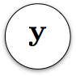
Variational inference
Variational inference approximates distributions
Optimization trick for parameter estimation
Approximation technique for intractable integrals
Simple example : Bayesian logistic regression
Data
Parameters
Logistic regression
Usually intractable integral

Slide 14
Classical inference approach
We have seen the Expectation-Maximization algorithm
It can be summarized as follows
E-step
M-step
Compute expectations
Use to compute M-step gradients

Slide 15
Stochastic inference approach
In general, we will not know the expectations
Gradient is of the parameters of the distribution
Expectation is taken on this distribution
We want to use an approximate distribution
Allows to optimize its parameters
Then we can compute expectation

Slide 16
Stochastic gradient estimator
All approaches can be summarized as
Two potential solutions
Score-function estimator
Differentiate the density
Pathwise gradient estimator
Differentiate the function

Slide 17
Score-function estimator
If we focus on differentiating the density
Gradient reweighted by the value of the function
Other names
Likelihood-ratio trick
REINFORCE algorithm
Automated inference
Black-box inference
When to use
Function is not differentiable
Density is easy to sample from
Density is known and differentiable

Slide 18
Pathwise gradient estimator
If we focus on differentiating the function
Introducing reparameterization
Find an invertible function that expresses as a transformation of a base distribution

Slide 19
Pathwise gradient estimator
If we focus on differentiating the function
Other names
Reparameterisation trick
Stochastic backprop
Perturbation analysis
When to use
Function is differentiable
Density can be approximated
Easy to sample from base distrib

Slide 20


Variational inference
We take back our inference problem
prior
posterior
likelihood
Could we transform this integral
Using a simpler and tractable distribution ?

Slide 21
Modeling the joint probability
Introducing
Jensen’s inequality

Slide 22
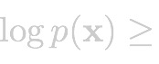

Variational inference
how to compute that?
Monte-Carlo estimator ?
… too much variance and hard to train
Reparametrization trick
stochastic part
deterministic part

Slide 23

Variational inference
Statistical divergences :
not symmetric :

Slide 24
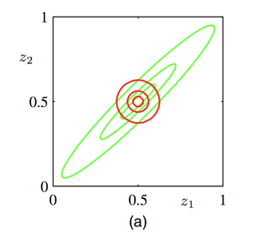
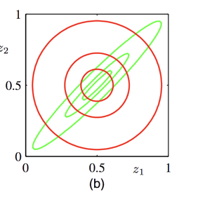
Variational inference
optimizing
optimizing

Slide 25
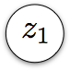
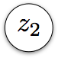
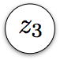
Mean-field approximation
flexible
easy to sample from
simple closed form
How to choose
Mean-field family
Each dimension has its own factor of variation
Compatible with conjugacy

Slide 26
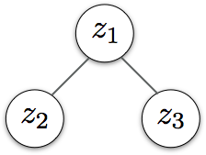
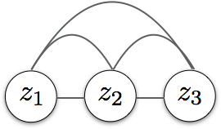
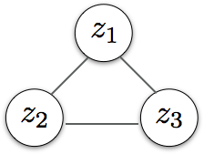
Approximation families
Least expressive
Mean-field family
structured
auto regressive
True posterior
Most expressive

